Slide 1
NYC Schools:
Forever Upward
Nujailah Noor, Ngoc Nguyen, Shawn Peckerman, Sangmin Lee

Slide 2
Table of Contents
Objectives
Introduction
Districts with Low Performance
Solutions to target Districts
1
3
5
2
4
6
Impact of Economic Need Index on Academic Performance
High Performing Schools with High ENI
Concluding Remarks

Slide 3
Objectives!
Our team was tasked to determine what kind of investment in disadvantaged schools across the NYC districts will increase academic performance.
What districts need the most help?
What indicators show a correlation for higher test scores?
Does the economic need index correlate with districts that did not meet expected performance?

Slide 4
Methodology
The Predictors For Education Performance
Subdividing Districts Based Upon (1)
Get Insights From Data Analysis of the Target Districts in Detail
Come up with the Solutions to Education System of the Target Districts.

Slide 5
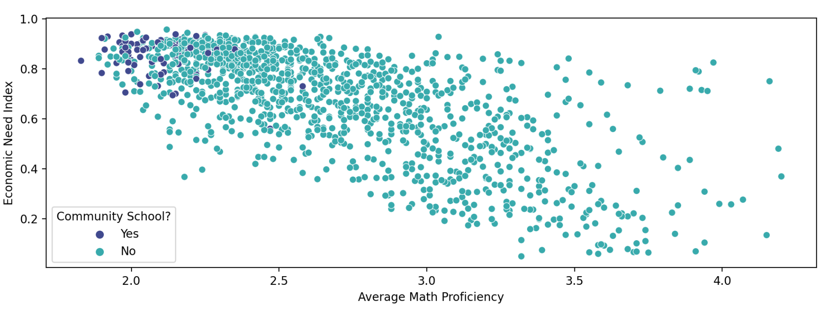
Relationship between types of school and students’ performances

Slide 6
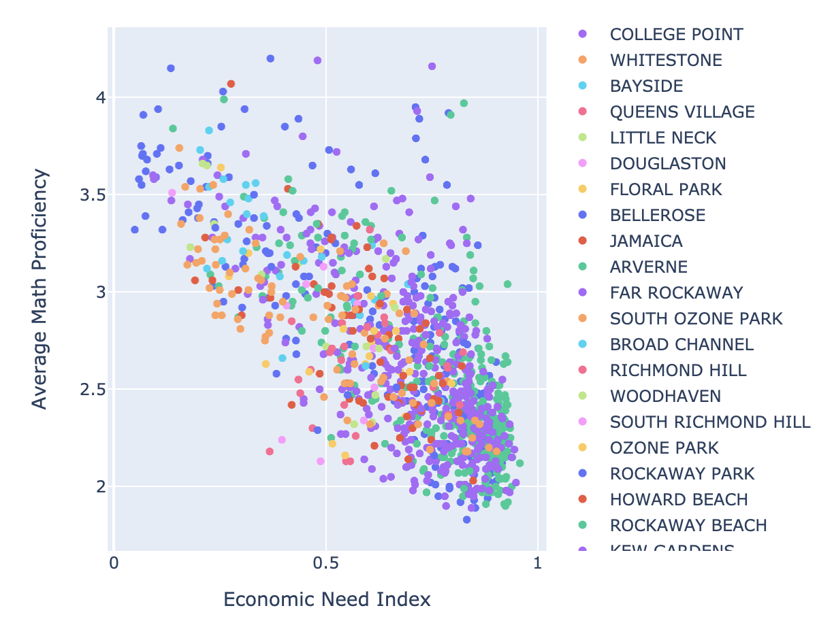
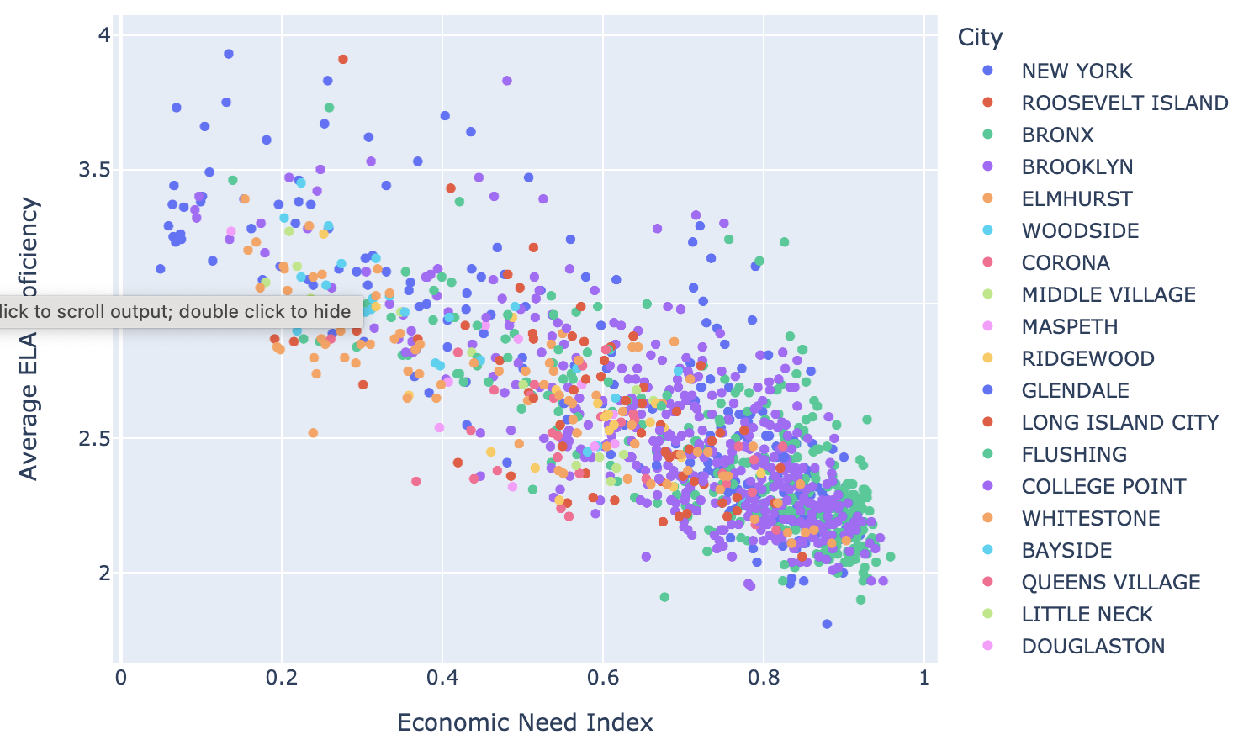
Relationship between students’ performances and Economic Need Index
There is a very strong negative correlation between the Economic Need Index and average ELA & Math scores
Correlation Between Avg ELA & ENI: -0.81
Correlation Between Avg Math & ENI: -0.72

Slide 7
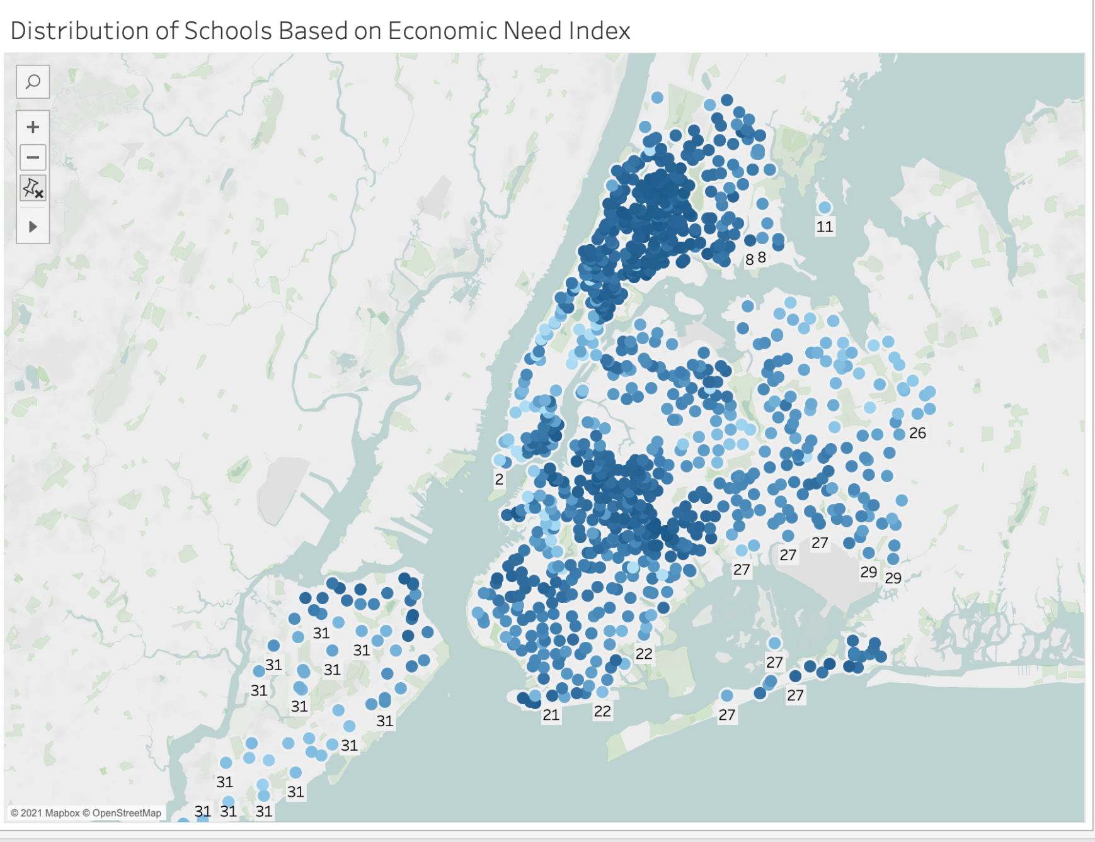
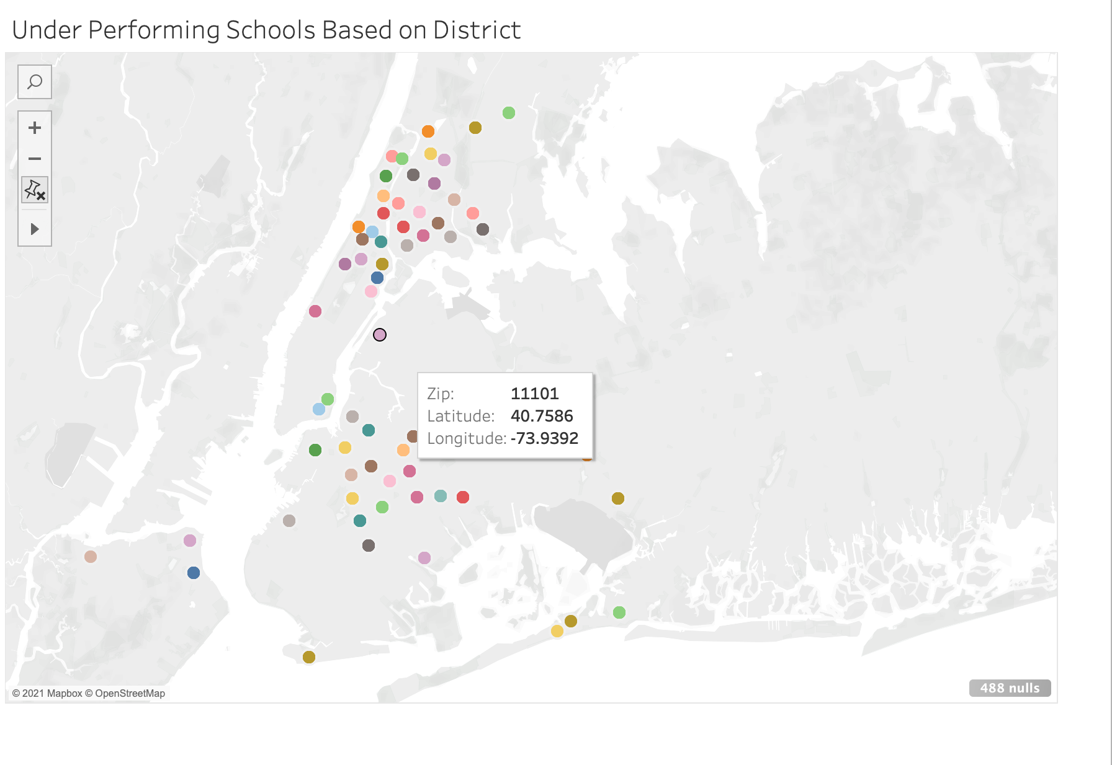
Distribution of Economic Need Index based on School Districts

Slide 8
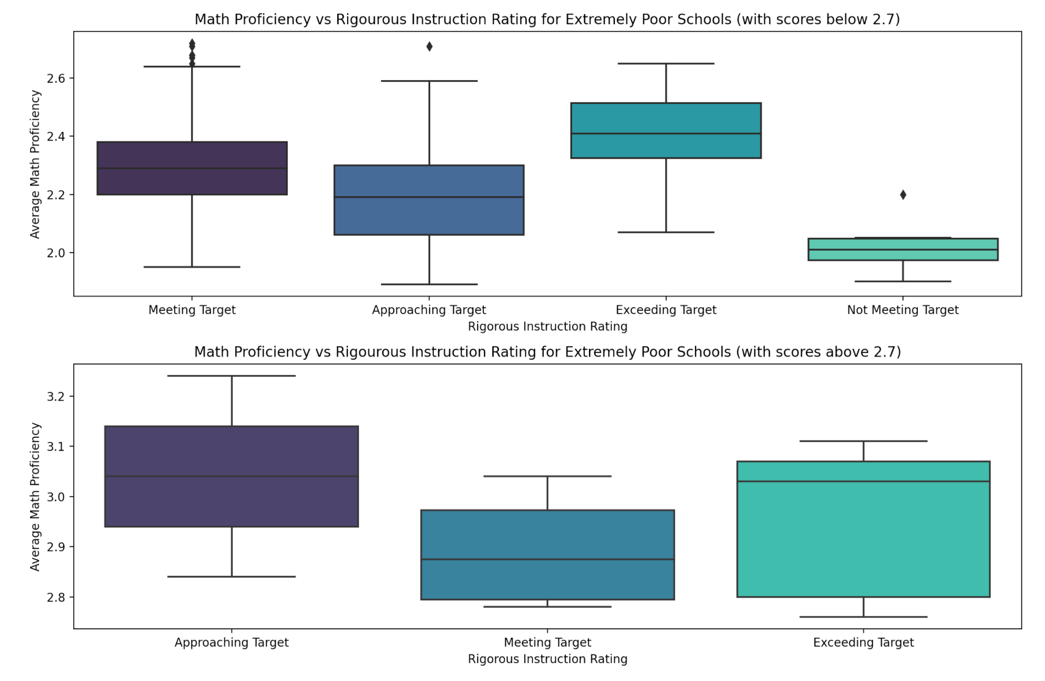
Relationship between Average students’ performances and Instruction Rating In
Target Districts

Slide 9
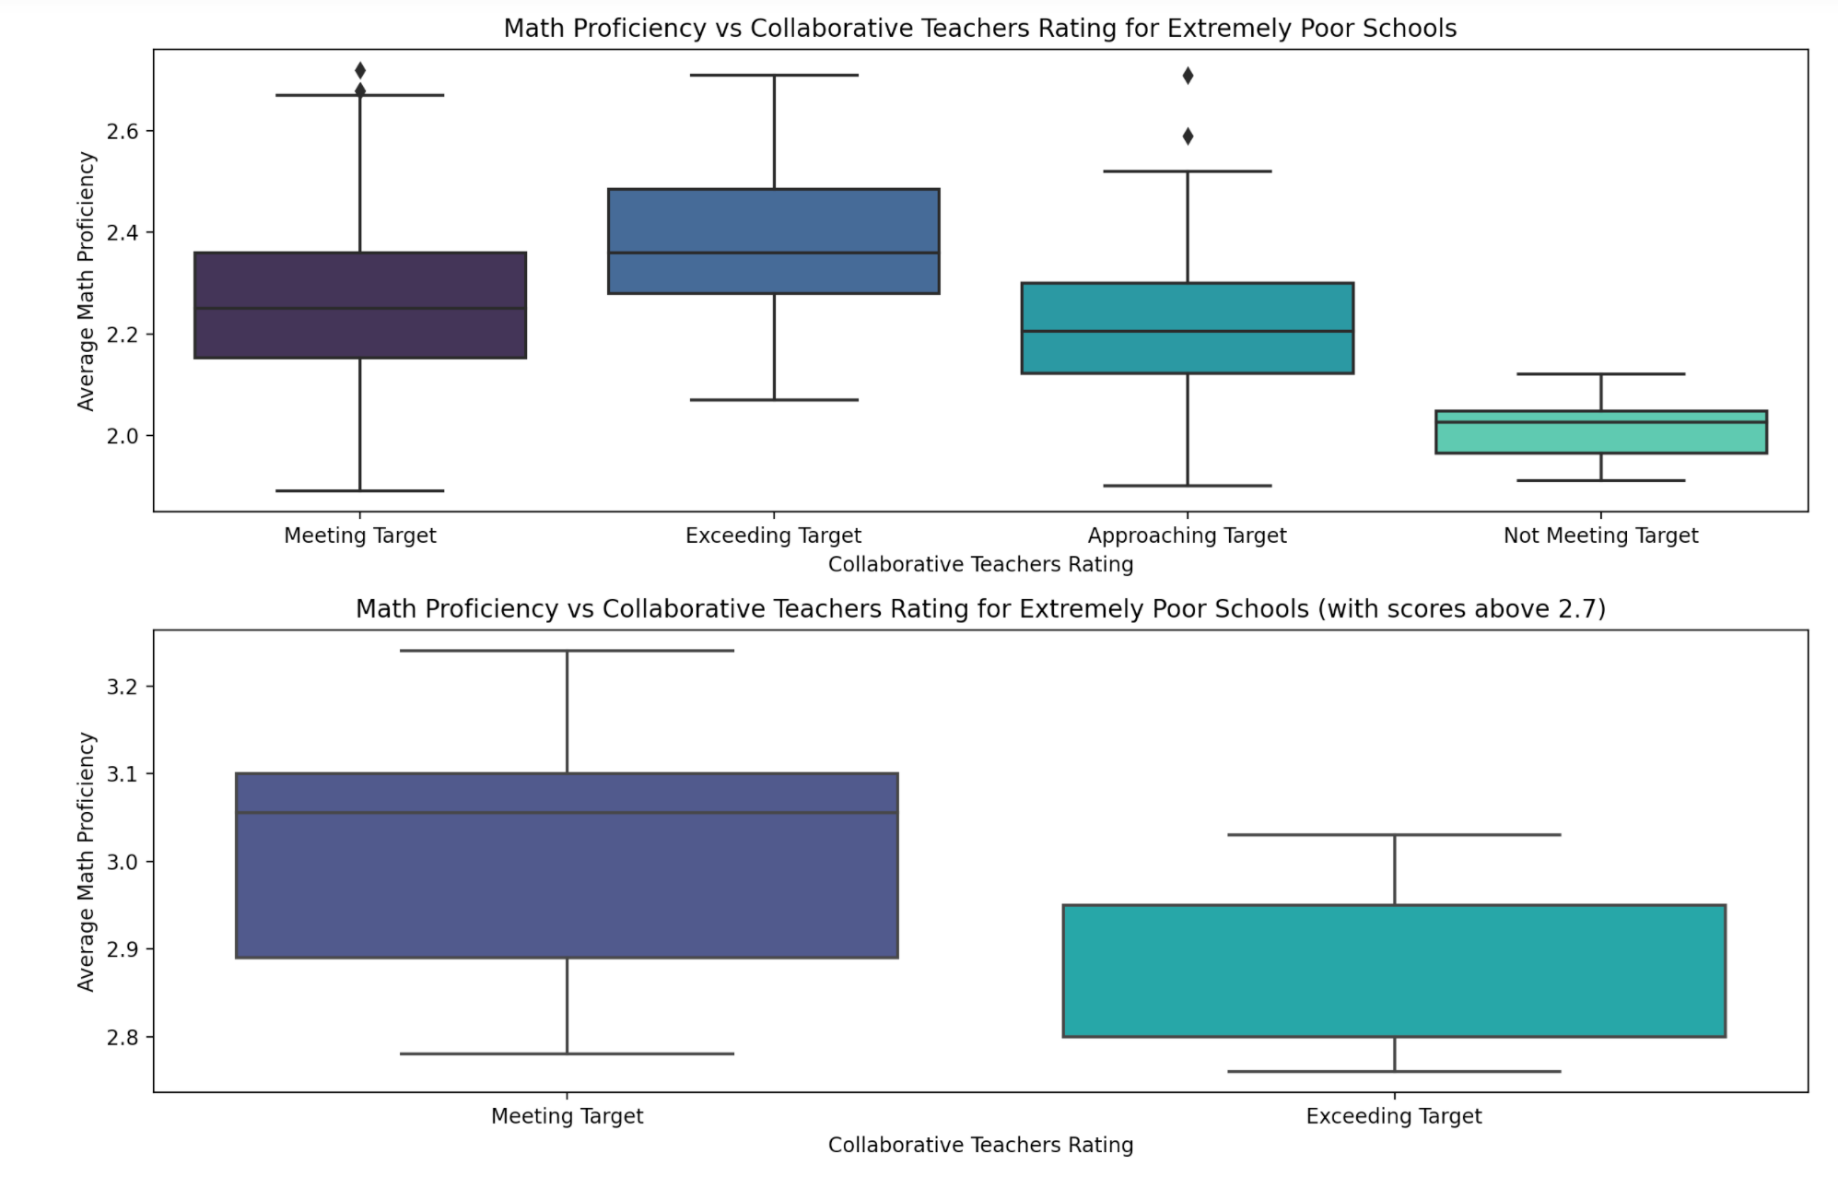
Relationship between Average students’ performances and Collaborative Teachers Rating In the Target Districts

Slide 10
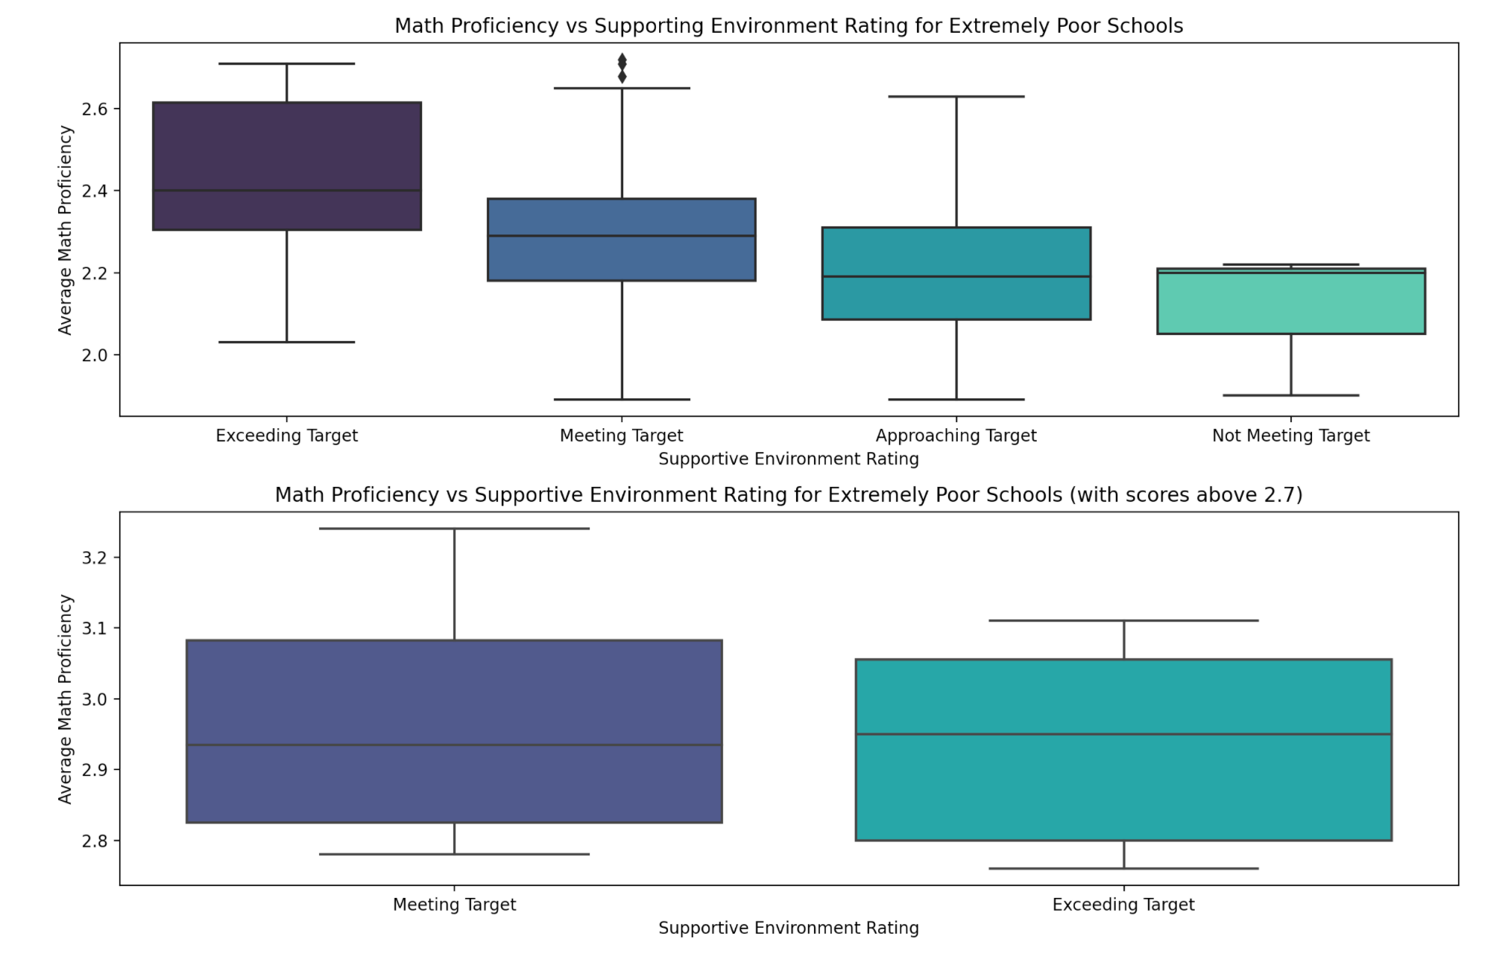
Relationship between Average students’ performances and Supportive Environment Rating

Slide 11
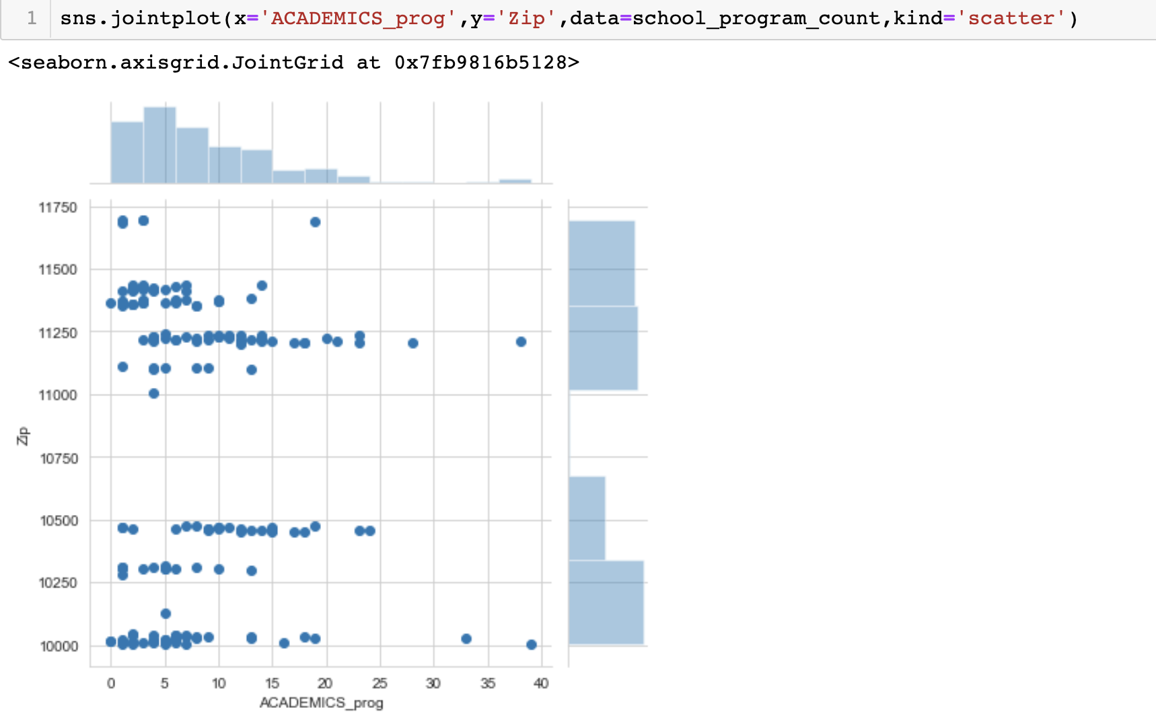
Academic Programs
By Zip Code

Slide 12
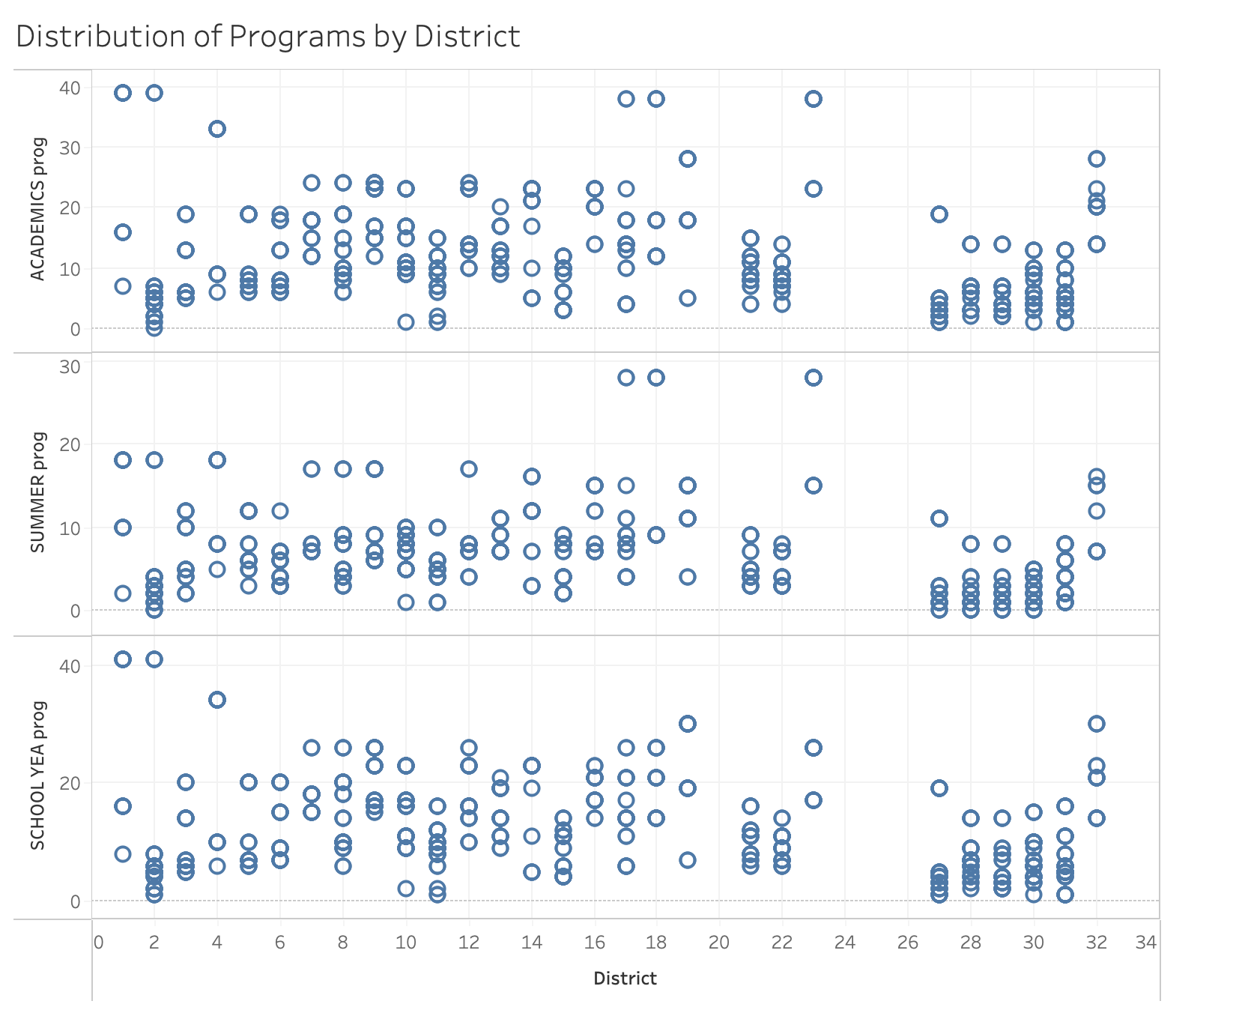
Academic Programs By
Target Districts

Slide 13
Our Recommendations
Invest in training teachers
Provide both personal & professional training
Re-Invent Course Curriculum
Create new curriculums that challenge students to think outside the box
Implement a supportive environment by hiring more psychologists & guidance counselors
Invest in Guidance Counselors & Psychologists
More extracurricular programs & academic programs
School Programs

Slide 14
Thanks!
Any questions? Comments or concerts?

